Slide 1
Introduction to Literature and Composition “The act of putting pen to paper encourages pause for thought, this in turn makes us think more deeply about life, which helps us regain our equilibrium.” ~Norbet Platt

Slide 2
Course & Common Core Goal
Students will not only appreciate literature and their own minds but also gain the knowledge and skills necessary to be successful in college courses and/or future careers.

Slide 4
Reading: Literature and Nonfiction
Note on range and content of student reading:
To become college and career ready, students must grapple with works of exceptional craft and thought whose range extends across genres, cultures, and centuries. Such works offer profound insights into the human condition and serve as models for students’ own thinking and writing. Along with high-quality contemporary works, these texts should be chosen from among seminal U.S. documents, the classics of American literature, and the timeless dramas of Shakespeare. Through wide and deep reading of literature and literary nonfiction of steadily increasing sophistication, students gain a reservoir of literary and cultural knowledge, references, and images; the ability to evaluate intricate arguments; and the capacity to surmount the challenges posed by complex texts.

Slide 5
Writing
Note on range and content of student writing:
For students, writing is a key means of asserting and defending claims, showing what they know about a subject, and conveying what they have experienced, imagined, thought, and felt. To be college- and career ready writers, students must take task, purpose, and audience into careful consideration, choosing words, information, structures, and formats deliberately. They need to know how to combine elements of different kinds of writing—for example, to use narrative strategies within argument and explanation within narrative— to produce complex and nuanced writing. They need to be able to use technology strategically when creating, refining, and collaborating on writing. They have to become adept at gathering information, evaluating sources, and citing material accurately, reporting findings from their research and analysis of sources in a clear and cogent manner. They must have the flexibility, concentration, and fluency to produce high-quality first draft text under a tight deadline as well as the capacity to revisit and make improvements to a piece of writing over multiple drafts when circumstances encourage or require it.

Slide 6
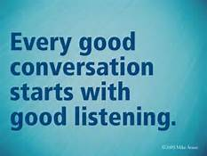
Speaking and Listening
Note on range and content of student speaking and listening:
To become college and career ready, students must have ample opportunities to take part in a variety of rich, structured conversations—as part of a whole class, in small groups, and with a partner—built around important content in various domains. They must be able to contribute appropriately to these conversations, to make comparisons and contrasts, and to analyze and synthesize a multitude of ideas in accordance with the standards of evidence appropriate to a particular discipline. Whatever their intended major or profession, high school graduates will depend heavily on their ability to listen attentively to others so that they are able to build on others’ meritorious ideas while expressing their own clearly and persuasively.
New technologies have broadened and expanded the role that speaking and listening play in acquiring and sharing knowledge and have tightened their link to other forms of communication. The Internet has accelerated the speed at which connections between speaking, listening, reading, and writing can be made, requiring that students be ready to use these modalities nearly simultaneously. Technology itself is changing quickly, creating a new urgency for students to be adaptable in response to change.

Slide 7
Language
Note on range and content of student language use:
To be college and career ready in language, students must have firm control over the conventions of standard English. At the same time, they must come to appreciate that language is as at least as much a matter of craft as of rules and be able to choose words, syntax, and punctuation to express themselves and achieve particular functions and rhetorical effects. They must also have extensive vocabularies, built through reading and study, enabling them to comprehend complex texts and engage in purposeful writing about and conversations around content. They need to become skilled in determining or clarifying the meaning of words and phrases they encounter, choosing flexibly from an array of strategies to aid them. They must learn to see an individual word as part of a network of other words—words, for example, that have similar denotations but different connotations. The inclusion of Language standards in their own strand should not be taken as an indication that skills related to conventions, effective language use, and vocabulary are unimportant to reading, writing, speaking, and listening; indeed, they are inseparable from such contexts.

Slide 8
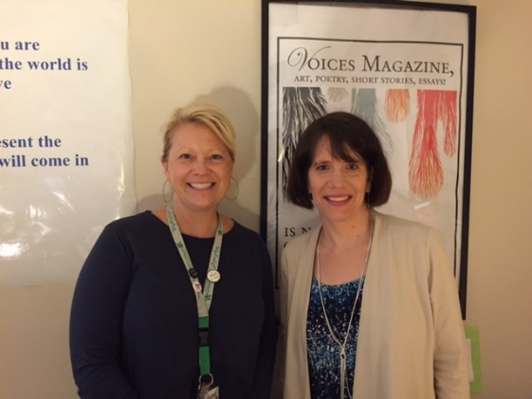
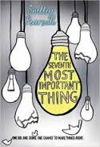
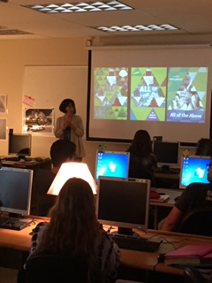
The Wildcat Read

Slide 9
The 5 Whys
The analysis process is essential to grow academically. Critical thinking and analysis is the moment you start to uncover multiple meanings to information, theories, statements and ideologies. The way we will venture into analysis this year is to practice the “5 whys”. This is a process of approaching a question or idea and then peeling back the layers (like the onion you see above). Today we will practice with the following question:
Example:
Why did I sign up to take English?
It is required
Why does MHS require English?
Because reading, writing, thinking, and speaking are important to being a successful/fulfilled human being
(answer this until you get through 5 whys)
The answer to the question initiates the next one…….Now you try:

Slide 10
Overarching Theme for 9th grade
The best way to understand yourself is to spend time with people whose beliefs differ from your own.

Slide 11
Students will need to obtain the following texts….
Quarter 1: Of Mice and Men, John Steinbeck
Quarter 2: 1984, George Orwell
Quarter 3: Macbeth, William Shakespeare
Quarter 4: To Kill a Mockingbird, Harper Lee

Slide 12
Communication
Fostering an open dialogue between school and home supports the growth of your child. If we embark on this together we can help our students achieve success.
3 ways I communicate:
Weekly letter (hardcopy in class/ posted on website)
Teacher website (announcements, weekly letter)
Text messages (new pilot program)
Google Classroom

Slide 13
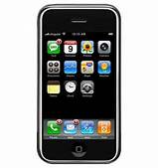
If you would like to receive the text messages for this class
Add as contact:216-586-2159
English I Honors: Text the message: @7392d
English I : Text the message: @7392d
When prompted, text me your name

Slide 14
Grading
GRADING
In Pinnacle, student grades are determined according
to the following weighted quarterly breakdown:
CATEGORIES
Reading – 40%
Writing – 40%
Speaking and Listening – 15%
Homework/Reading Checks– 5%

Slide 15
Mastery Grading 4-point scale
4=A: exceptional understanding of learning
target=mastery (even goes beyond expectation and synthesizes with text-self, text-world, text-text)
3=B: meets expectation for learning target
2=C: approaching/developing understanding of learning target
1=D: significant gaps in understanding learning
target
0=F: no understanding of learning target OR did not
attempt to complete assignment

Slide 16
English Department Policies
LATE WORK
No Late Work will be excepted
MAKE UP WORK FOR TESTS/QUIZZES
Tests and quizzes must be made up on the Wednesday morning following an absence (this includes the Wednesday following a Tuesday absence) or by appointment with the teacher. A Student has up to one week after an absence to make up the test or quiz. Work not made up will receive a “Z.”
REWRITES (PAPERS)
Writing instruction is a process; therefore, students will receive feedback from the teacher prior to the deadline in the form of formative assessments and consults. Thus, all major writing assignments are final, polished pieces and will be graded as such.

Slide 17
RETAKES
Tests and quizzes aim to show student gained learning at a specific time. Thus, there will be no retakes on tests and quizzes.
PLAGIARISM
This statement must be submitted on all major student papers. Each student must sign below this statement to indicate that he/she is aware of this policy.
“Plagiarism is taking and using someone else’s thoughts, ideas, words, or work and failing to acknowledge its author(s). In following the school’s policy, students will receive a zero for any plagiarized work no matter the degree or extent.”
**Students will receive instruction about how to avoid plagiarizing using MLA citation.

Slide 18
How Can I Help My Child?
Late work is not accepted so help your student with time management skills
Encourage your student to make a conference with me
Ask for help--help your student be proactive about their academic career. Even if you coach them on what to say, have them practice the face-to-face communication. It will really empower them.
Call me or email me; kbeery@mayfieldschools.org
440-995-6954
I am available for extra help 3rd, and 8th periods or before or after school by appointment.

Slide 19
Final Notes, Hints for Success
Encourage your child to read. Take him/her to the library or bookstore and initiate at least an hour of outside reading a day.
Read the book with your child. Ask questions and have him/her come into class with questions.
Encourage your son/daughter to approach reading/writing as a process and not a race. Bite off tasks in small digestible chunks, ask for outside readers, and make changes.

Slide 20
Final Notes, Hints for Success
Ask to read over his/her paper. Point out any place that you are confused. Start a discourse using a elevated vocabulary and ask for textual evidence to support statements.
Read the paper. Does each sentence make sense? Start to elevate writing style, master format, and add sentence variety. If you don’t feel comfortable doing this at home, please encourage your son/daughter to set up a conference

Slide 21
Thank you for trusting me with your child. It is a great honor. I am trusting someone with my two as well! I promise yours are in good hands.

